Slide 1



MERN – ES6 + React
Module 02 HTML - II

Slide 2
Outline
Module 02
HTML Intermediate
Tables designing using ordered and unordered list
Actions based input tags
Labels and display fields

Slide 3
Tables
Displaying your Data

Slide 4
Tables Used to Be Evil
Tables are meant for
tabular data, not for layout

Slide 5
Design
Make sure to sketch your layout before you code.
Decide on the number of rows and columns
Decide if any rows/columns will span multiple cells

Slide 6
The Tags
<table> – the container tag
<tr>…</tr> - the rows
<td>...</td> - the columns

Slide 7
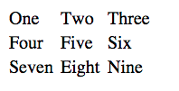
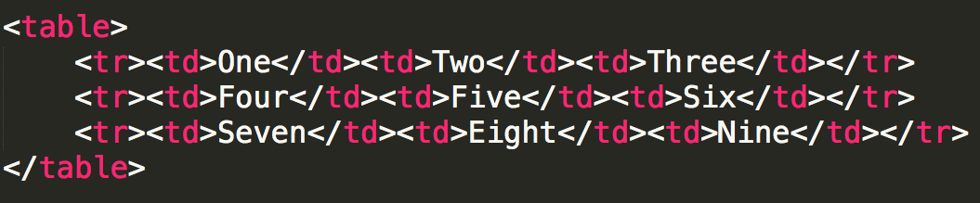
Simple Table

Slide 8
Table Headings
How would you add table headings? (The bold cells at the top that define the data.)
Some people use bold font, we use semantic tags
<th>..</th> -- table heading

Slide 9
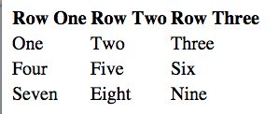
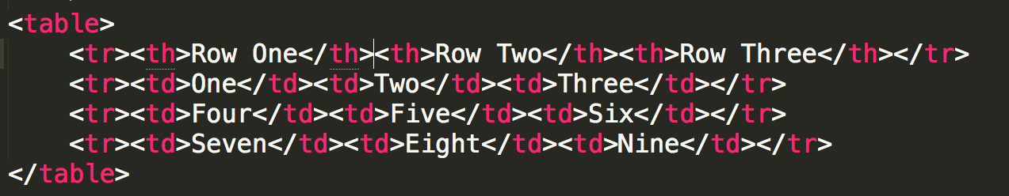
Table Headings

Slide 10
Spanning Multiple Cells
It may be the case that your table won’t be a perfect grid.
You can combine multiple rows and/or columns using the rowspan and colspan attributes.

Slide 11
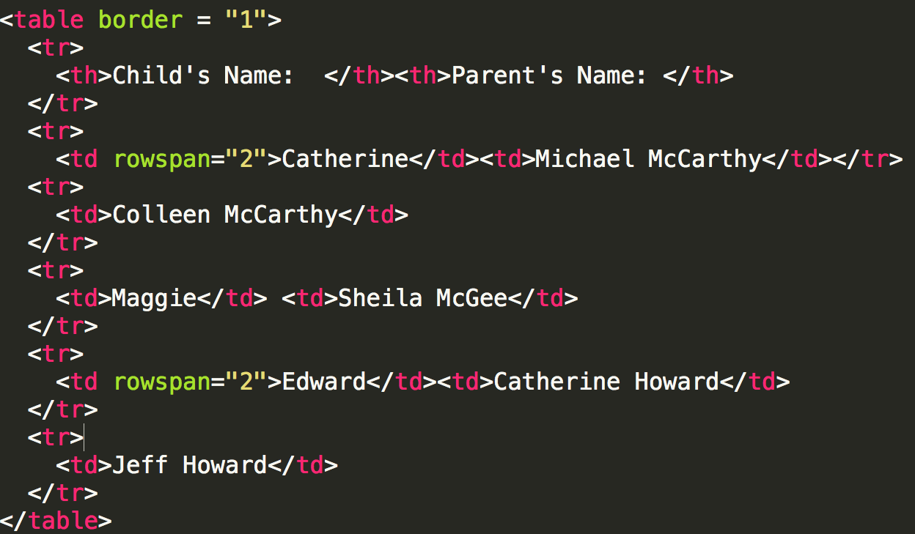

Slide 12
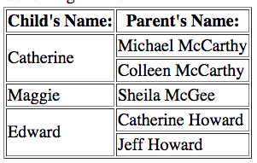

Slide 13
Captions
How do you link text to the table? A heading (h2, h3, etc.) will look good, but doesn’t provide semantics.
Use <caption>

Slide 14
04.01 Simple Forms
INTERACTIVITY WITH JAVASCRIPT
Simple Forms

Slide 15

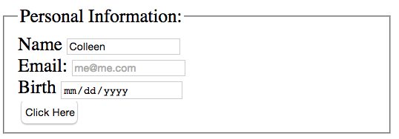
04.01 Simple Forms
INTERACTIVITY WITH JAVASCRIPT
Forms
One place where you often see JavaScript is in form validation

Slide 16
04.01 Simple Forms
INTERACTIVITY WITH JAVASCRIPT
Forms
Forms add a new layer to the Request- Response Cycle

Slide 17

04.01 Simple Forms
INTERACTIVITY WITH JAVASCRIPT
Web Development
Front end
What you are developing... What happens on the browser/client
side
HTML, CSS, JavaScript
Back end
What the server is handling
Python, Ruby, PHP, Perl, Java, Node

Slide 18

04.01 Simple Forms
INTERACTIVITY WITH JAVASCRIPT
HTML Form Tags
<form>
<label>
<input>
<form>
<label for='name'>Name</label>
<input type='text' id = 'name' name = 'name'> <br/>
<label>Email: <input type='email' name = 'email’></ label><br/>
<label for='birth'>Birth</label>
<input type='date' id = 'birth' value = 'birth'><br/>
<input type = 'submit’ value =“Click Here”>
</form>

Slide 19
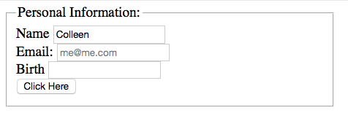
04.01 Simple Forms
INTERACTIVITY WITH JAVASCRIPT
Chrome
Firefox

Slide 20

04.01 Simple Forms
INTERACTIVITY WITH JAVASCRIPT
Form elements have attributes
type
name
id

Slide 21

04.01 Simple Forms
INTERACTIVITY WITH JAVASCRIPT
Input Types
textfield
email
password
radiobutton
checkbox
submit

Slide 22

04.01 Simple Forms
INTERACTIVITY WITH JAVASCRIPT
More input types
number
range
color
date
url

Slide 23

04.01 Simple Forms
INTERACTIVITY WITH JAVASCRIPT
Attributes
name
Almost all input types should have a name attribute
The name attribute is assigned whatever value is input
id
Used for labels
Used for by JavaScript

Slide 24

04.01 Simple Forms
INTERACTIVITY WITH JAVASCRIPT
Additional Attributes
value
button: text inside the button
textfield: provides a default value
If not changed, will be the value passed to the server
placeholder
Provides a suggestion
Not an “official” value

Slide 25
HTML5 Multimedia
Designed to avoid the use of extra software to play music/video
Not fully implemented

Slide 26
Video element <video>
Video tag uses a src attribute or embedded <source>
Common attributes
height, width
autoplay
loop
controls
Text inside <video>..</video> is displayed if browser can not support tag

Slide 27
Audio element <audio>
Audio tag uses a src attribute to link to audio file, typically .mp3 or .wav
Common attributes
autoplay, controls, loop
buffered
muted
volume

Slide 28
Summary
Module 02
HTML Intermediate
Tables designing using ordered and unordered list
Actions based input tags
Labels and display fields

